Slide 1
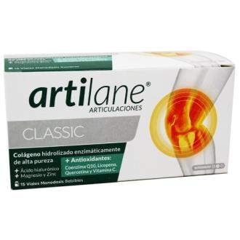
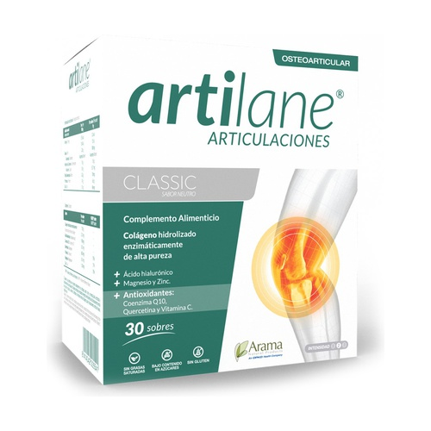
Artilane Classic : (Drinkable Vial (15 Vial)
Artilane Classic Sachets (30 Sachets)
Vial (drinkable ) | Enzymatic Hydrolysed Collagen of high purity | Vial (drinkable solution (box contain 15 single dose vials ) | Raspberry Flavored and sweetener by with Sucralose
 | Lycopene
 | Hyaluronic acid
 | Coenzyme Q10
 | Quercetin
 | Vitamin C
 | Magnesium
 | Zinc
Artilane Classic- Sachet | Sachet | Enzymatic Hydrolysed Collagen of high purity | Sachet (box contain 30 sachet ) | Apple Flavored sweetener by with Sucralose
 |  | Hyaluronic acid
 |  | Coenzyme Q10
 |  | Quercetin
 |  | Vitamin C
 |  | Magnesium
 |  | Zinc

